Slide 1
BD.Cab

Slide 2
Subsystems:
1.Registration subsystem.
2.Profile subsystem.
3.Trip-start subsystem.
4.Trip-end subsystem.

Slide 3
Registration: Typical course of events
Actor’s Action(passenger & Driver) | System response
1)None | 2)Ask for information.
3) Provide username , password, email .etc. | 4)Verify distinct email-id and username.
 | 5)Send confirmation email.

Slide 4
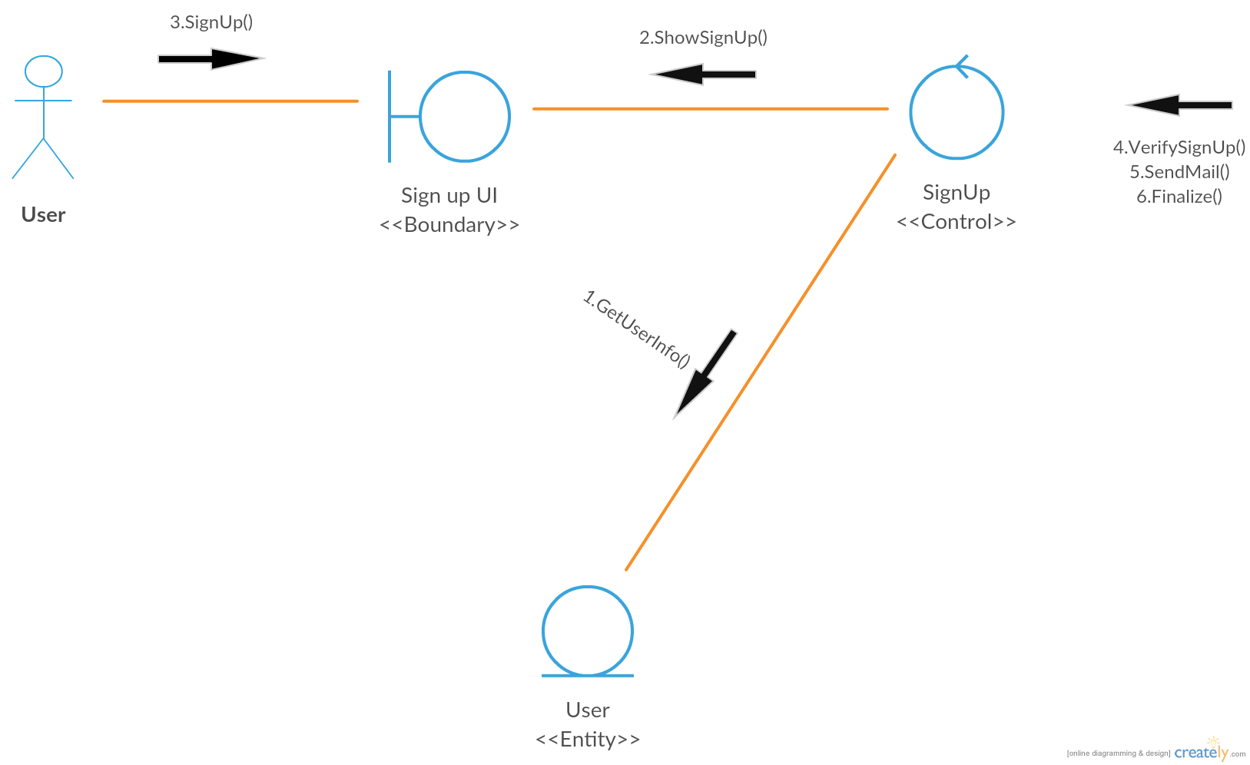

Slide 5
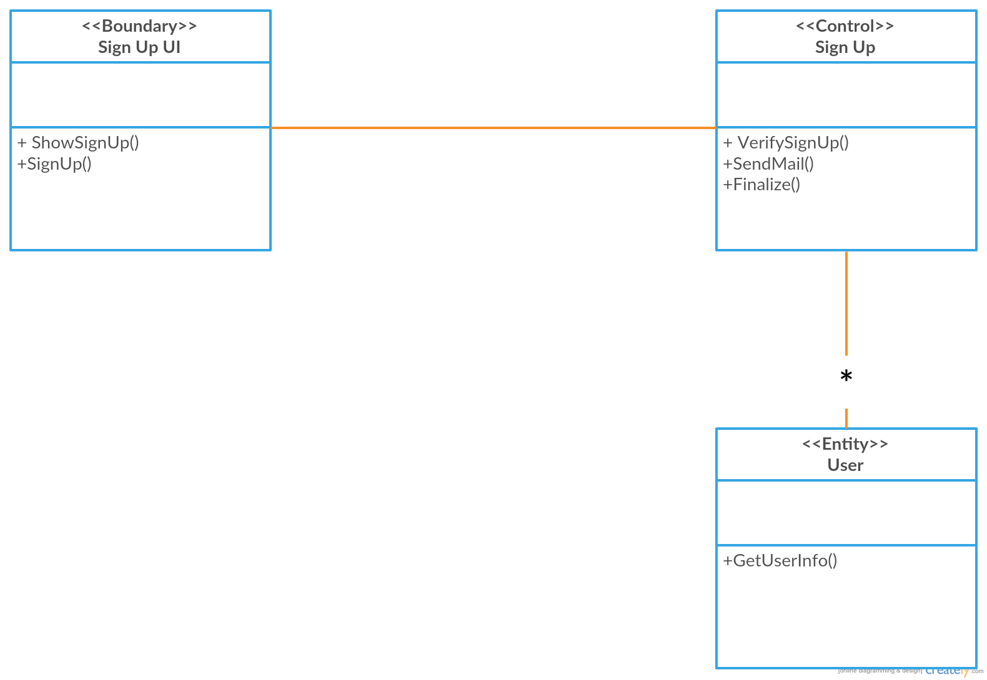

Slide 6
Login : Typical course of events
Actor’s Action | System Response
1)None | 2)Ask for user name and password.
3) Provide username and password. | 4)Authenticate username and password.
 | 5)Give access .

Slide 7
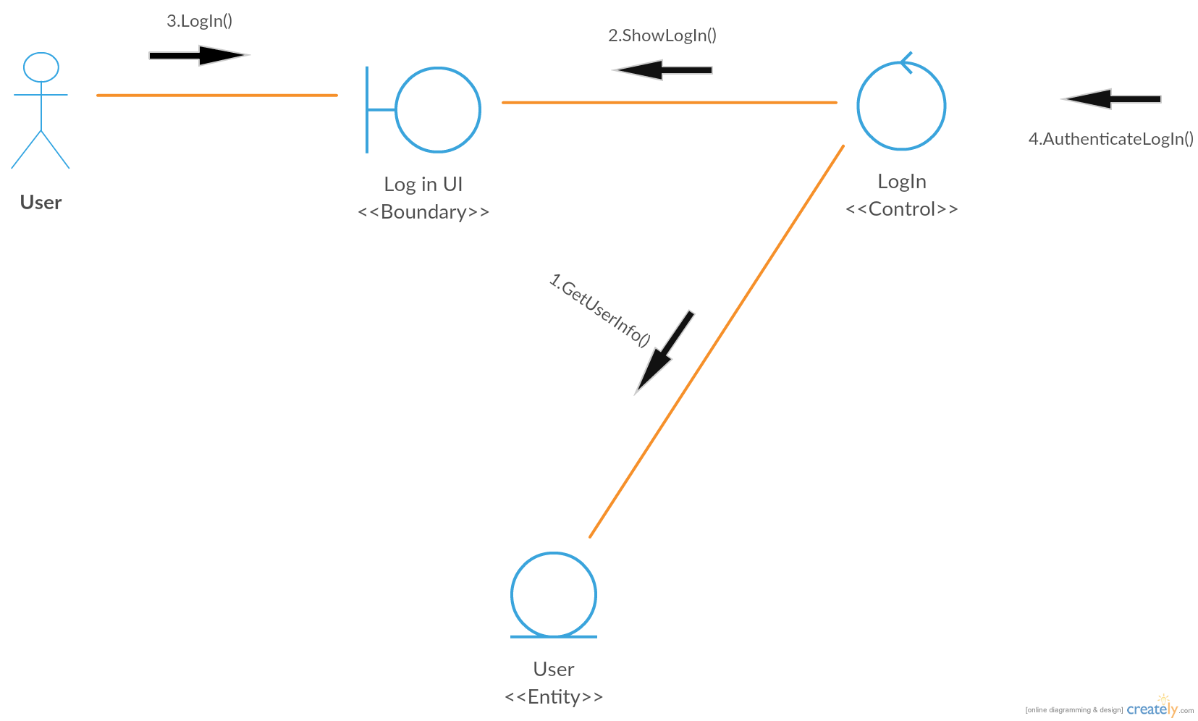

Slide 8


Slide 9
Actor | System Response
1.Select profile | 2.Show profile
3.Update profile | 4.Verify update
 | 5.Confirm update
 | 6.Save update

Slide 10
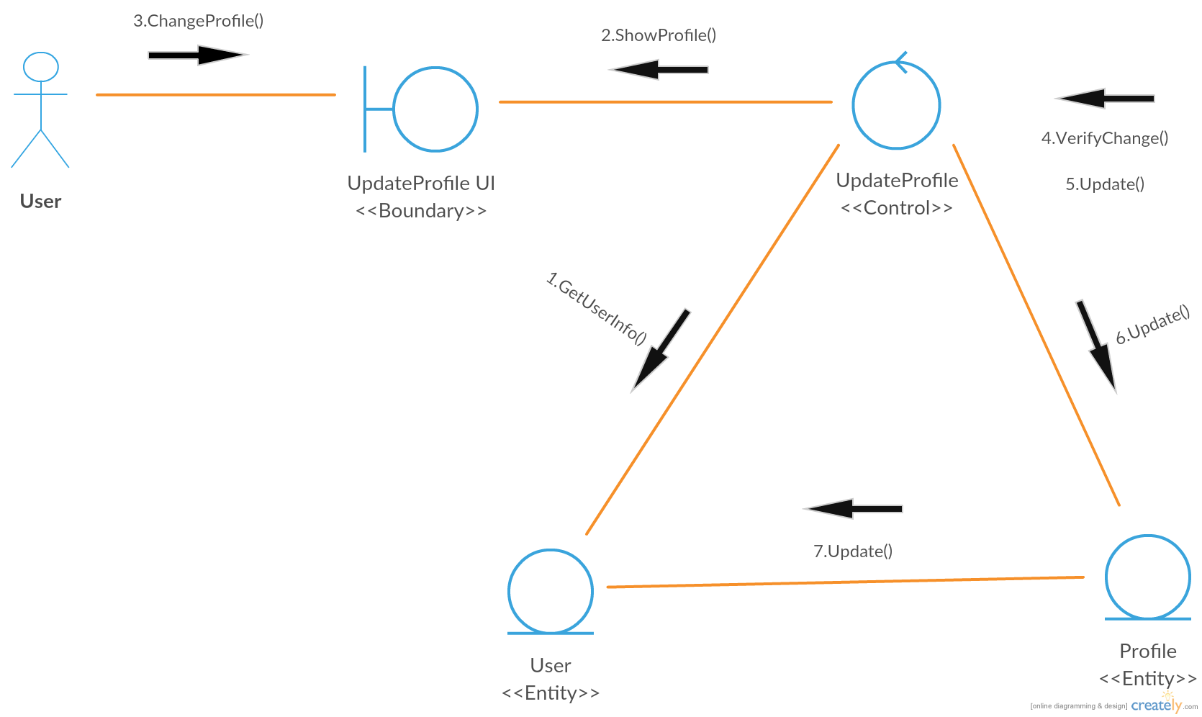

Slide 11
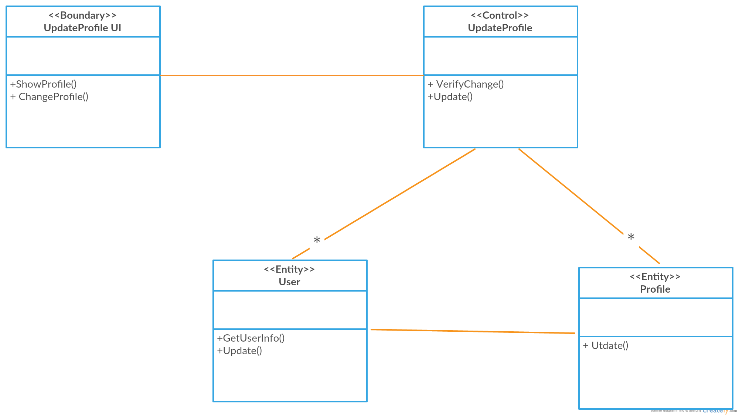

Slide 12
PREVIOUS TRIPS
Actor | System
1.Select previous list | 2.Show previous list

Slide 13
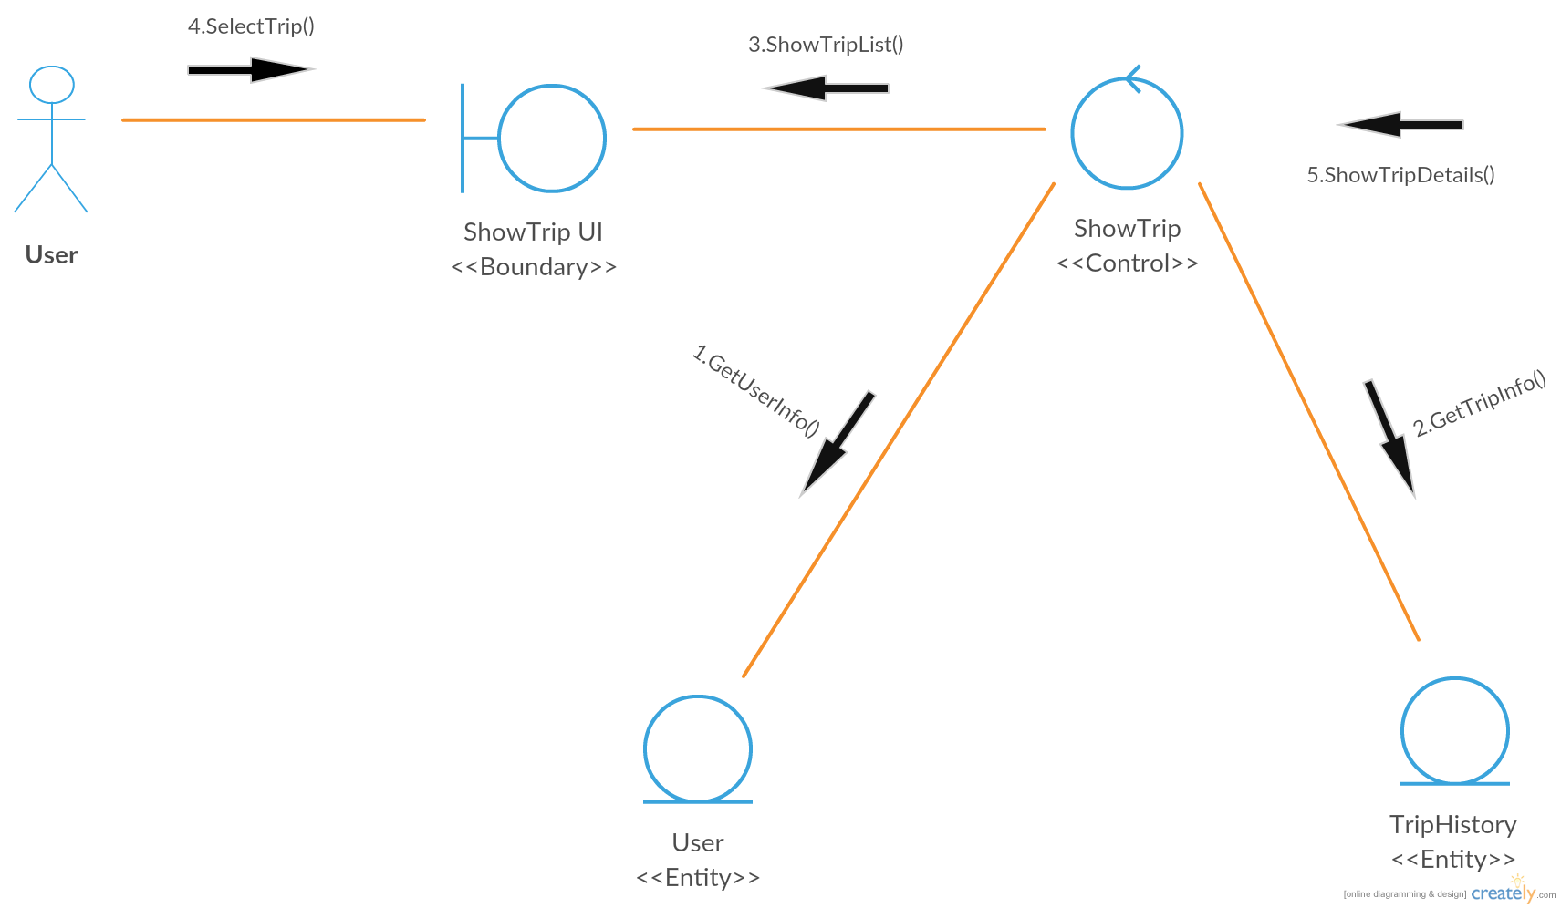

Slide 14
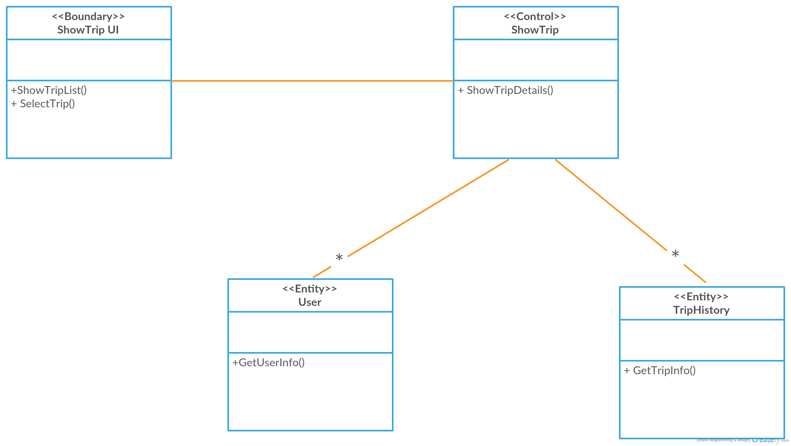

Slide 15
Actor(Passenger) | System
1.None | 2.Get current location of Passenger
 | 3.Ask for destination
4.Provide destination | 5.Get destination
 | 6.Verify the route under service
 | 7.If the root is not under service notify passenger
 | 8.Else confirm destination

Slide 16
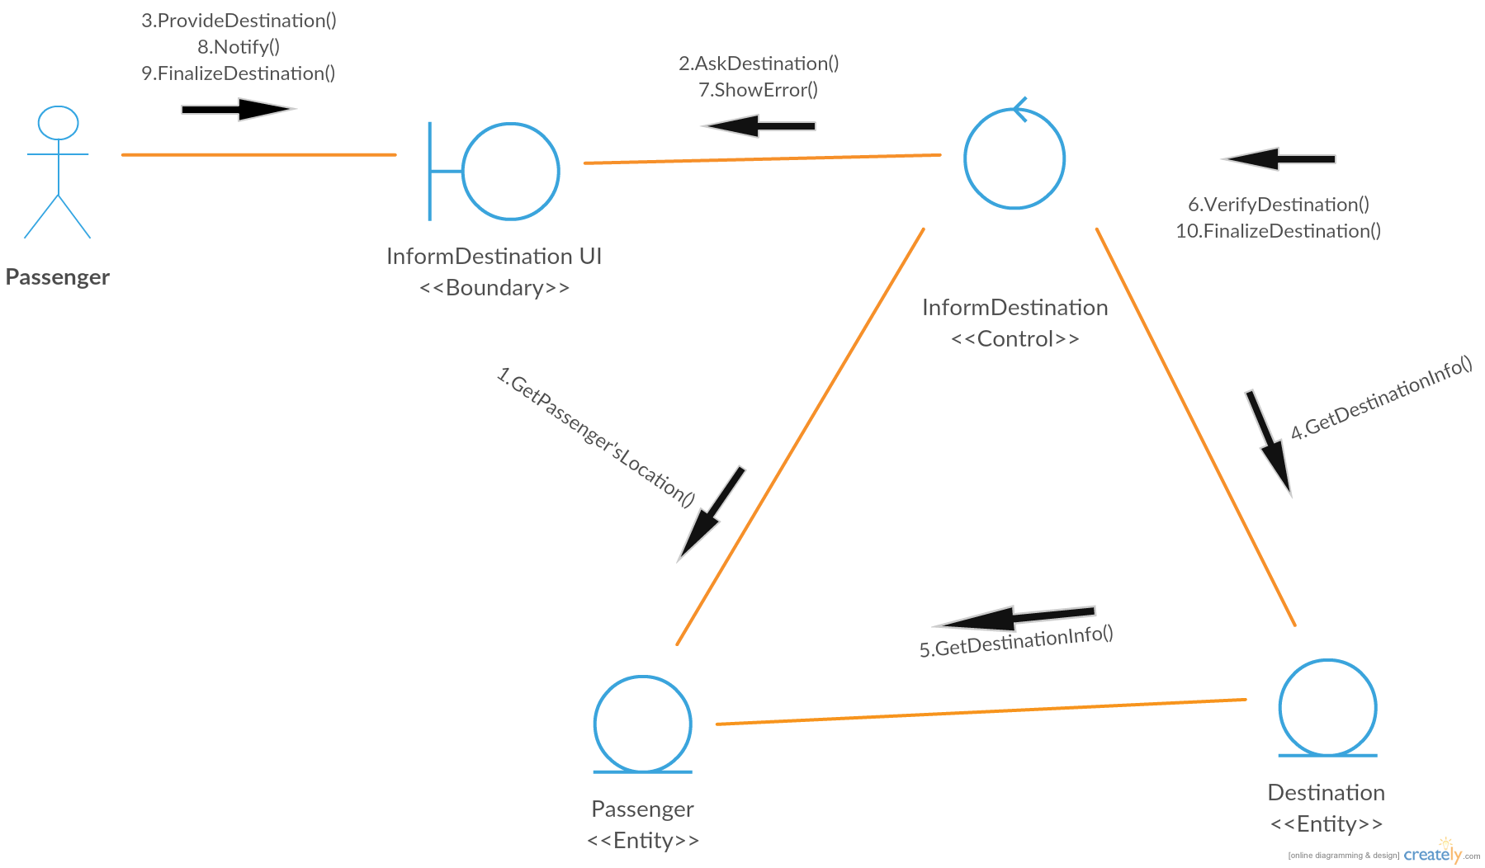

Slide 17
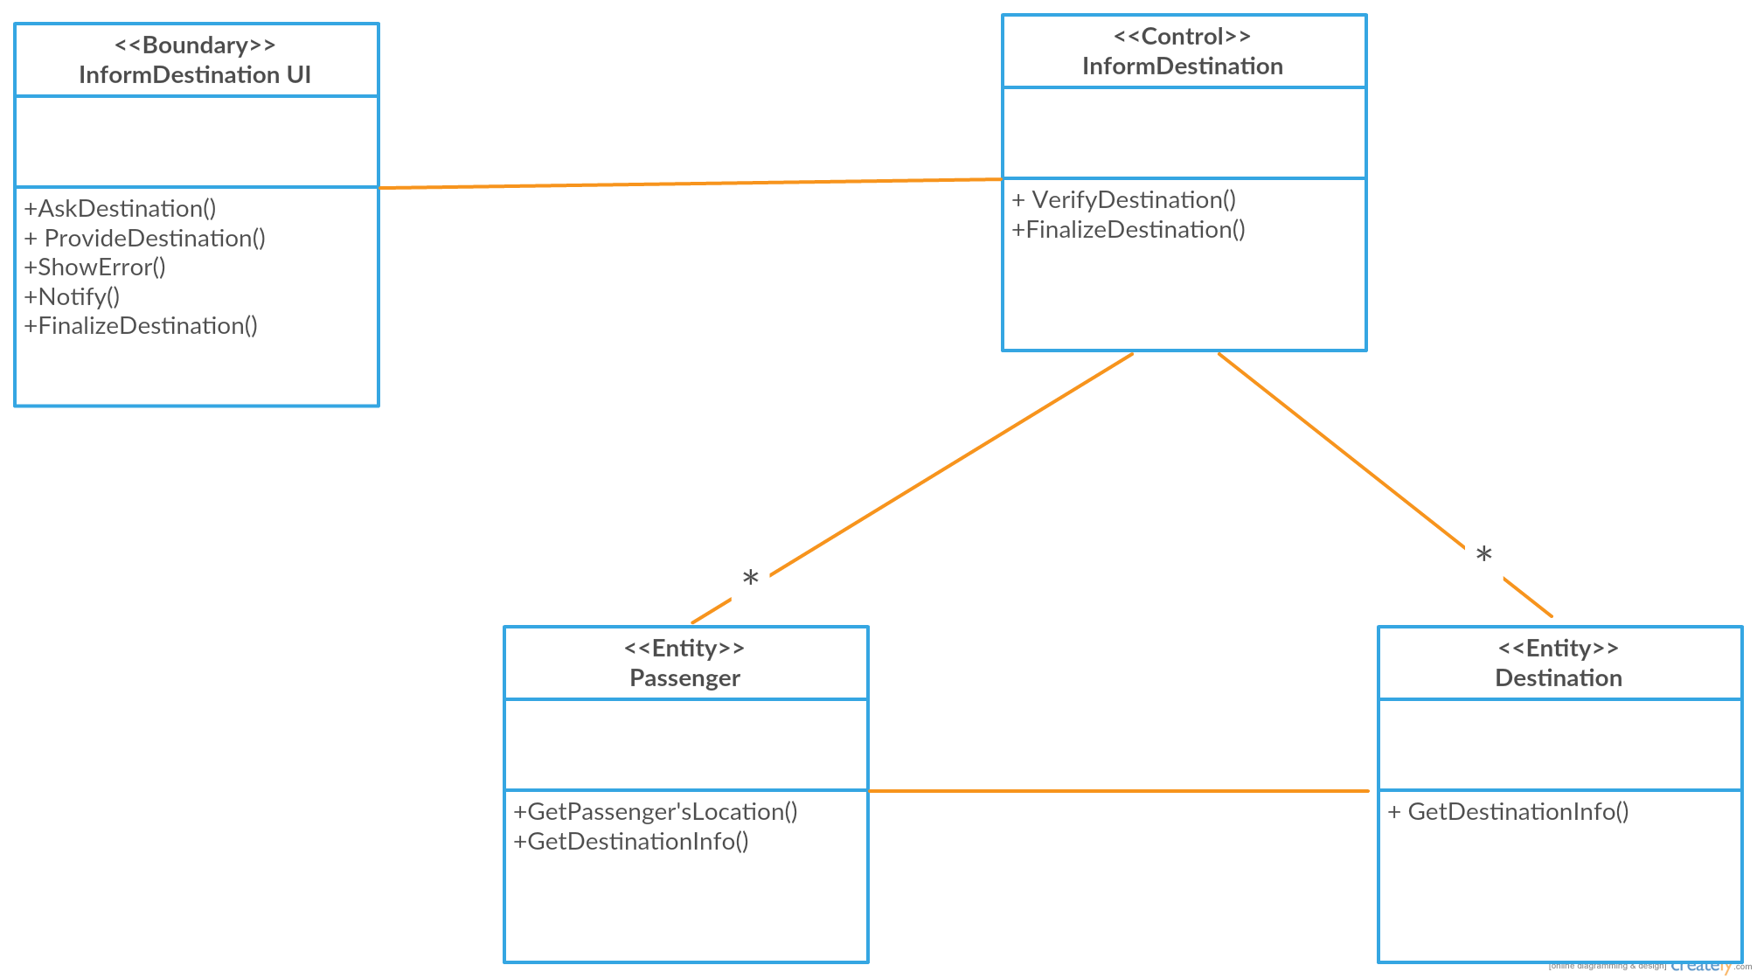

Slide 18
Actor(Driver) | System
 | 1.Notify selected driver
 | 2.Send map from driver’s current location to passenger’s location
3.Confirm arrival to passenger | 4.Send map to go destination

Slide 19
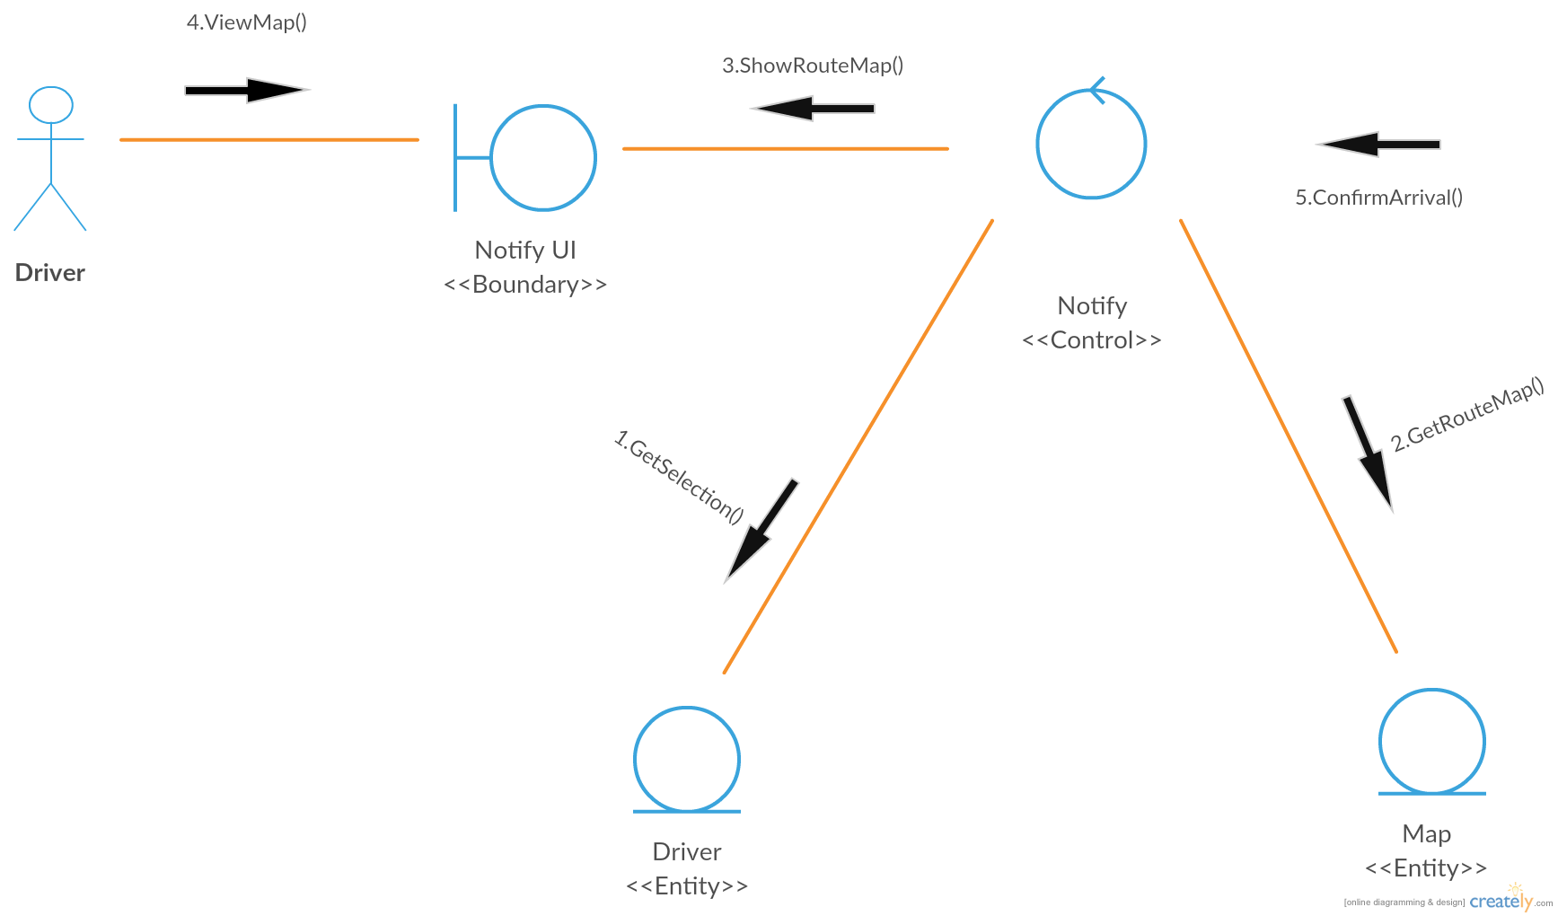

Slide 20
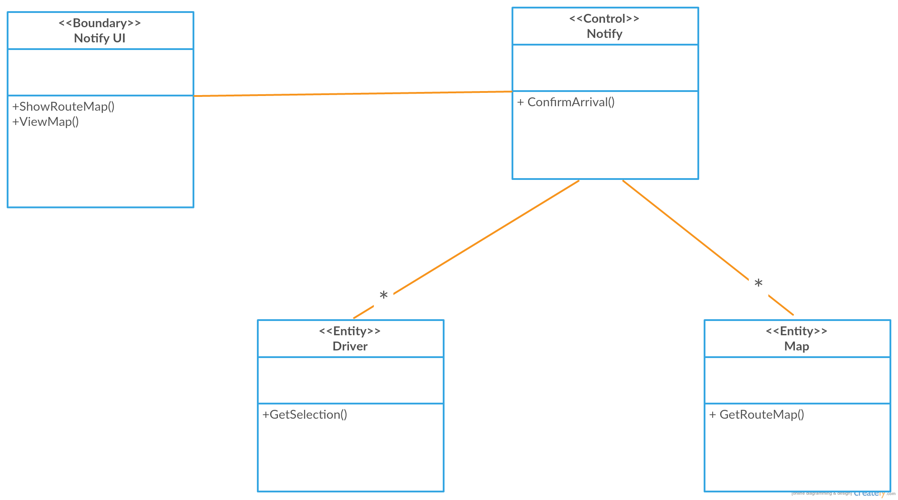

Slide 21
Confirm end of the trip
Actor(passenger) | Actor(Driver) | System
 |  | 1.Calculate distance
 |  | 2.Calculate fare
 |  | 3.Show fare
4.Fulfill fare | 5.Receive fare | 6.Confirm successful payment

Slide 22
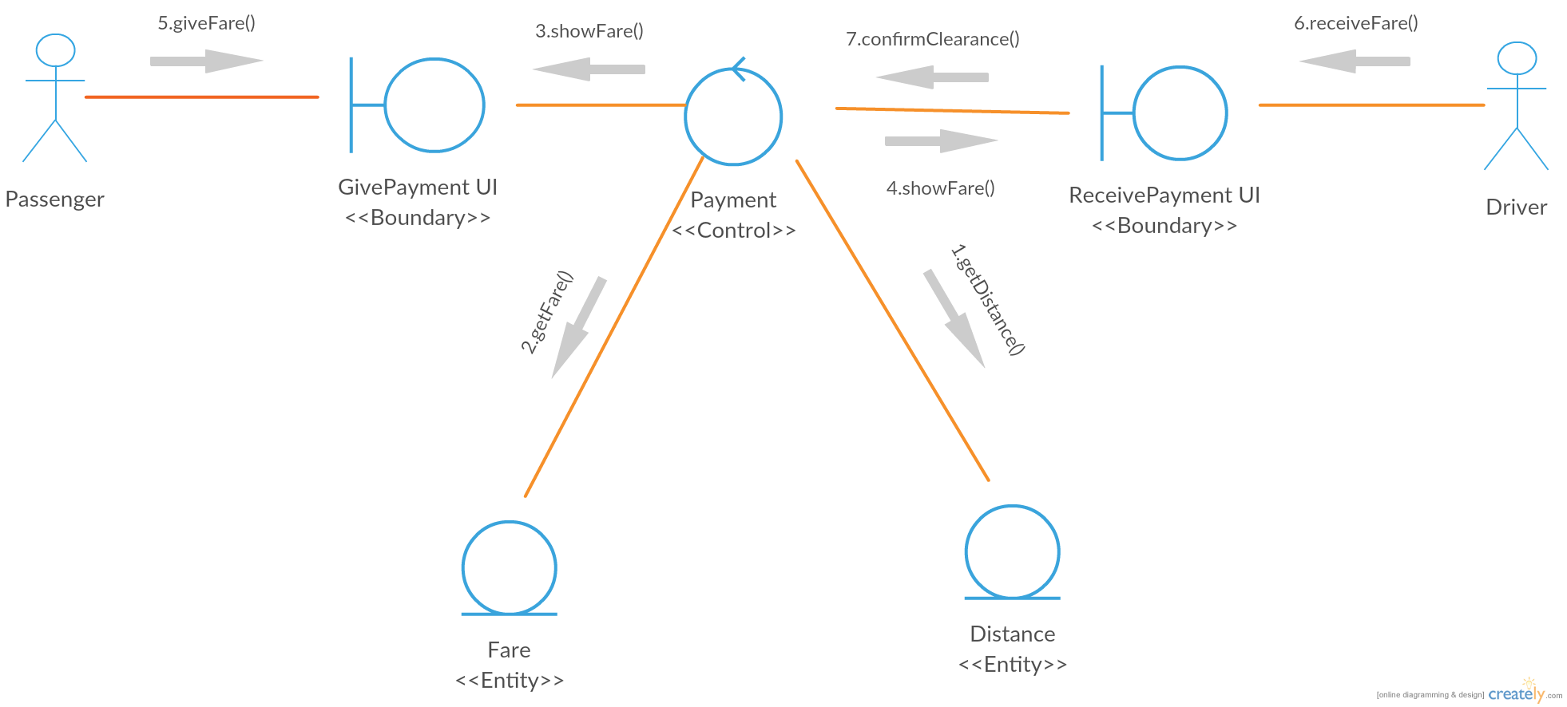

Slide 23
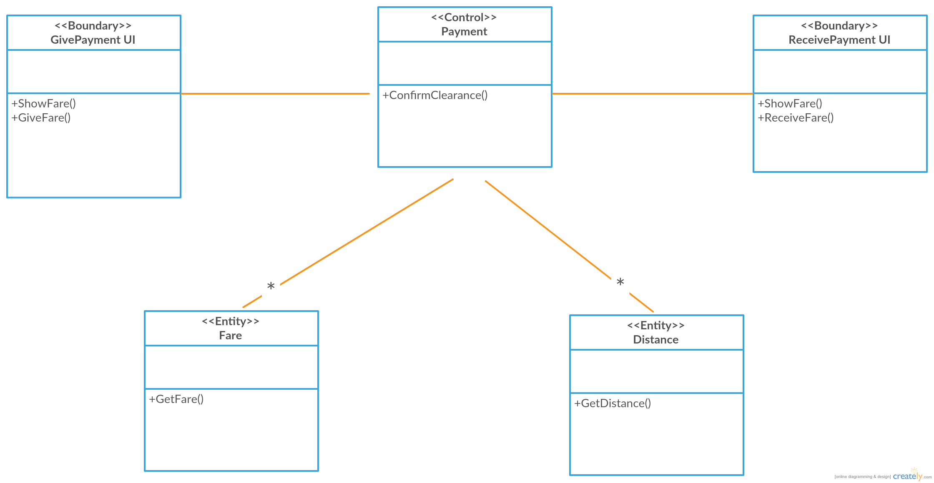

Slide 24
Actor(Passenger) | Actor(Driver) | System
1.Give rating |  | 2.Save rating
3.Give comments |  | 4.Save given comments
 | 5.See rating and comments

Slide 25
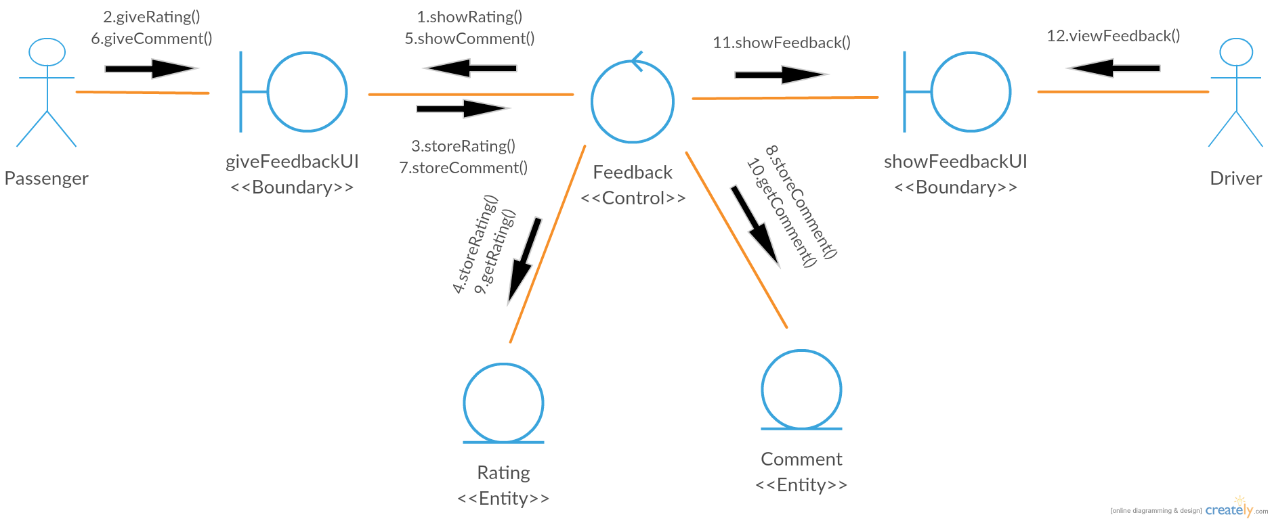

Slide 26
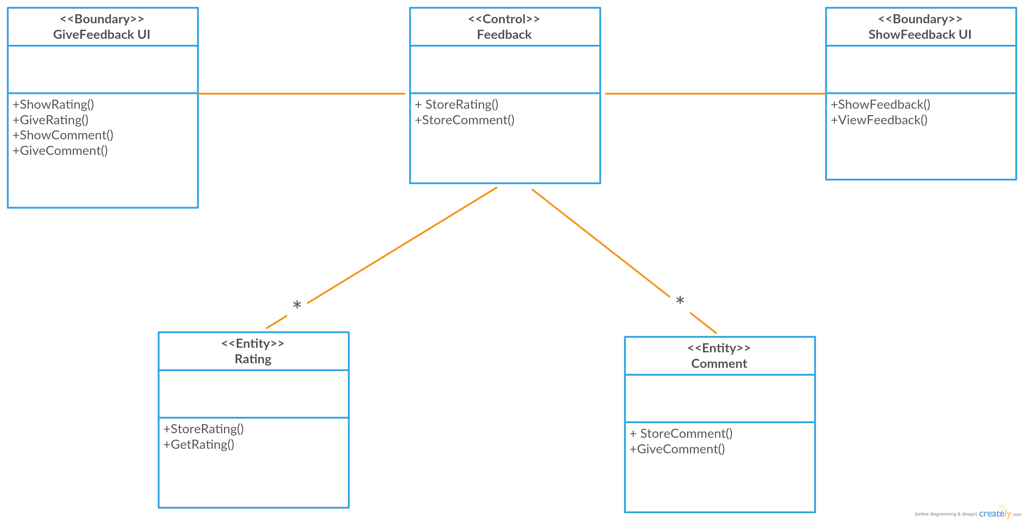

Slide 27
THANK
YOU

